Slide 1
Analysis of Used Car Sales
Results presentation

Slide 2
DATA IMPORTATION AND CLEANING
The imported data had a total of 26 variables with 426880 values/rows
Data Cleaning
The data cleaning process involved;
Step 1: Excluding non-essential variables
Step 2: Converting the Postingdate in date format and extracting relevant components
Step 3: Handling outliers – Outliers in the price variable were determined by the use of interquartile range.
Step 4: Removing duplicates using a unique identifier “id”

Slide 3
Data Cleaning
Step 5: Dealing with missing values (categorical values were filled using the mode, while numeric values were filled using media, text format, dates and location missing values were eliminated)
Step 6: Converting the variables to the appropriate format
Step 7: Eliminating additional variables from the dataset and
Step 8: Storing the clean version of data in CSV format.
The final dataset has 367800,rows and 15 columns

Slide 4
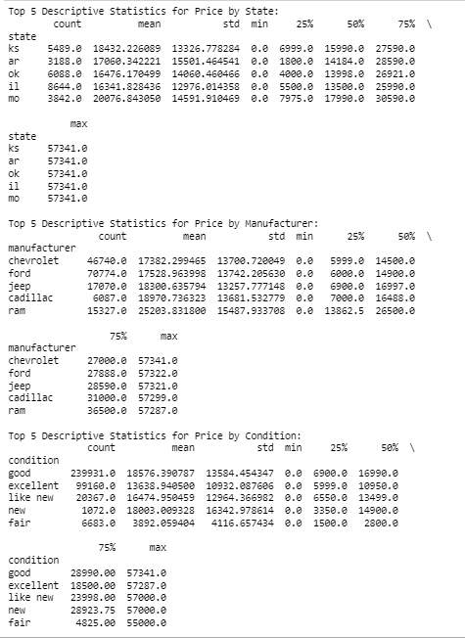
Descriptive statistics
State Analysis: Kansas (ks) had the highest mean price with a maximum price of $57,341. Arkansas (ar), Oklahoma (ok), Illinois (il), Missouri (mo): Follow with descending mean prices.
Manufacturer Analysis: Ram had the highest mean price among the top 5 manufacturers, with a maximum price of $57,287. Chevrolet, Ford, Jeep, Cadillac: Follow with descending mean prices.
Condition Analysis: Good Condition has the highest mean price among the conditions, with a maximum price of $57,341. Excellent, Like New, New, Fair: Follow with descending mean prices.

Slide 5
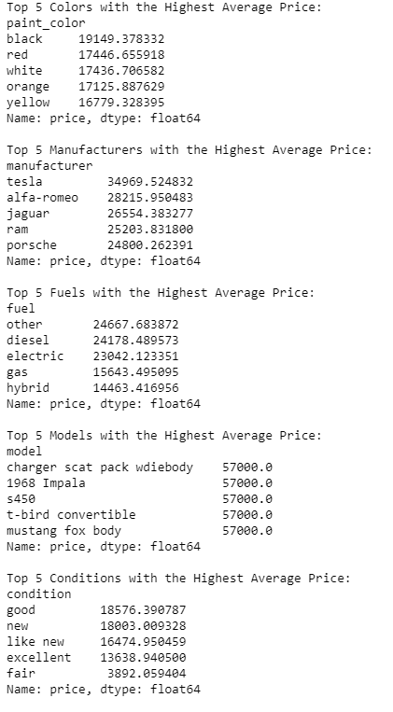
Descriptive statistics
Top 5 Colors with the Highest Average Price:
Black: Black-colored cars have the highest average price, suggesting a preference for this classic and sleek color.
Red: Red cars come second in average price, often associated with sportiness and style.
Top 5 Manufacturers with the Highest Average Price:
Tesla: Tesla, known for its electric vehicles, takes the lead in average price, emphasizing the premium nature of electric cars.
Alfa Romeo: Alfa Romeo, a luxury brand, secures the second spot, appealing to those seeking high-end and performance-oriented vehicles.

Slide 6
Descriptive statistics
Top 5 Fuels with the Highest Average Price:
Other: Vehicles with alternative fuels not categorized as diesel, electric, or hybrid have the highest average price, showcasing diverse and premium fuel options.
Diesel: Diesel-powered vehicles come next, known for fuel efficiency and torque, especially in larger vehicles.
Top 5 Conditions with the Highest Average Price:
Good: Cars classified as in "good" condition have the highest average price, indicating a preference for vehicles that are well-maintained but not necessarily brand new.
New: Brand-new cars have the second-highest average price, as expected, reflecting their pristine condition and the cost of new vehicles.

Slide 7
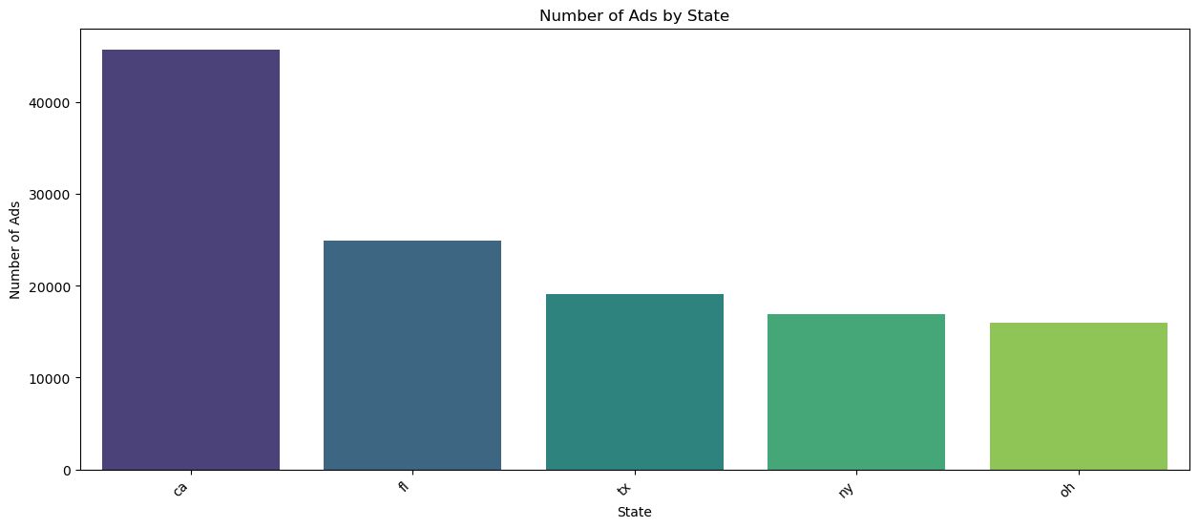
Explanatory data analysis (Insights)
The plot shows top 5 state most occurring in the advertisement platform.
California is the most occurring state followed by Florida, Texas, New York and Ohio.
The subset was done to obtain the top states since there are numerous states represented in the data.

Slide 8
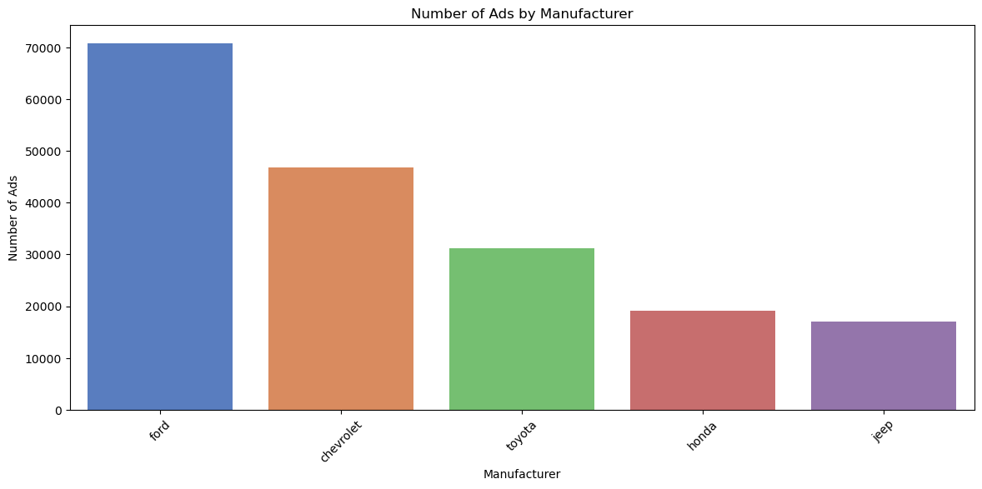
Number of ads by manufacturer
Plot
Number of ads by manufacturer
The plot shows the top 5 manufaturers in the united states to engage in advertisements.
Ford have the highest number of advertisements followed by Chevrolet and then Toyota, Honda and Jeep.

Slide 9
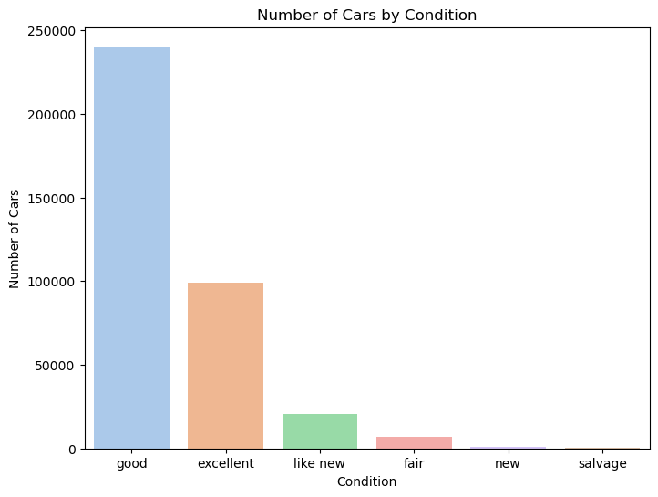
Number of cars by condition
The plot shows the number of cars by condition.
Cars in good condition are the most advertised and marketed on the platform followed by Excellent cars.
Least advertisement and marketing goes to salvage cars.

Slide 10
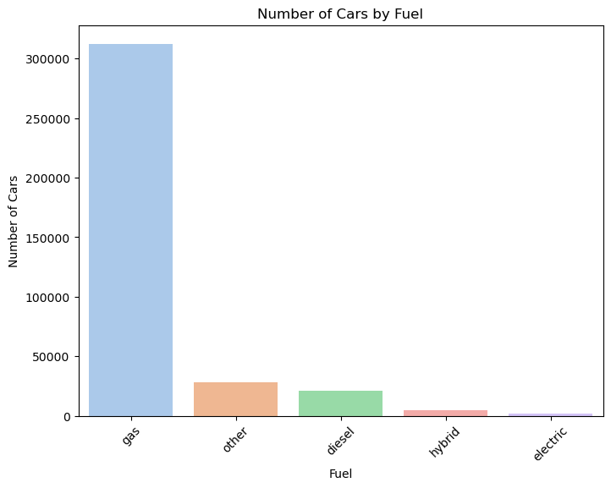
Number of cars by fuel
This plot shows the number of cars against the type of fuel used.
From the plot, most cars advertised use gas (petrol).
The gap between gas and other categories is huge which means that most manufacturers concentrate on the production of petrol driven vehicles.

Slide 11
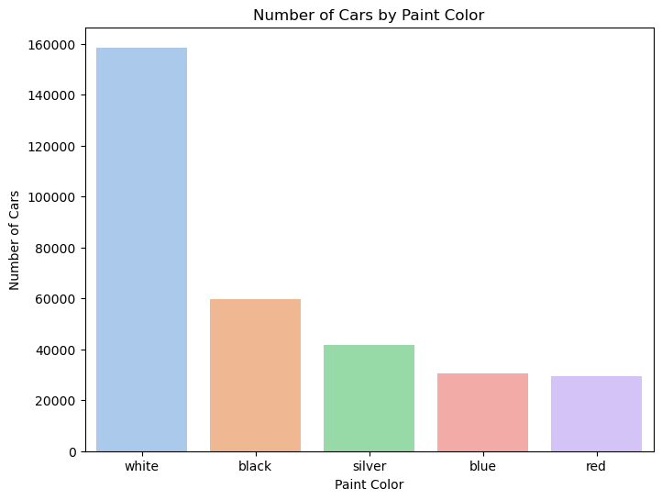
Number of cars by color
The plot shows number of cars against the color of the car.
White cars are the most marketed despite earlier statistics showing that Black cars are the most demanded.
Black vehicles fall second, then; silver, blue and red cars respectively.

Slide 12
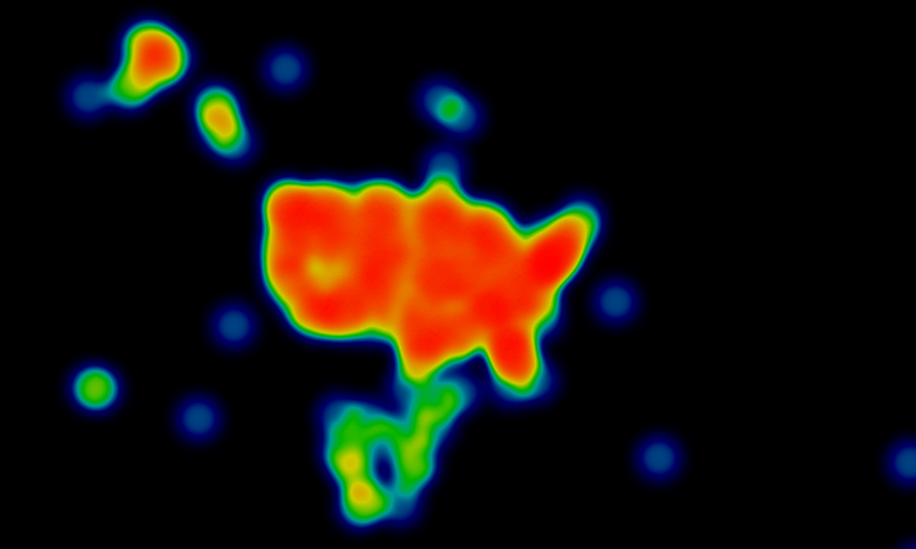
Geospatial analysis
Geospatial analysis was done to visualize the distribution of different advertisements and vehicles across the united states.
The plot was developed using latitude and longitude variables.
The red clusters represent the highly concentrated advertisements and great markets of vehicles.

